Slide 1
Chapter 1:
Introduction
What is an Operating System?
Mainframe Systems
Desktop Systems
Multiprocessor Systems
Distributed Systems
Clustered System
Real -Time Systems
Handheld Systems
Computing Environments
Operating System Concepts
1.1
Silberschatz, Galvin and Gagne 2002

Slide 2
What is an Operating System?
A program that acts as an intermediary between a user of a computer and the computer hardware.
Operating system goals:
  Execute user programs and make solving user problems easier.
  Make the computer system convenient to use.
Use the computer hardware in an efficient manner.
Operating System Concepts
1.2
Silberschatz, Galvin and Gagne 2002

Slide 3
Computer System Components
Hardware – provides basic computing resources (CPU, memory, I/O devices).
Operating system – controls and coordinates the use of the hardware among the various application programs for the various users.
Applications programs – define the ways in which the system resources are used to solve the computing problems of the users (compilers, database systems, video games, business programs).
Users (people, machines, other computers).
Operating System Concepts
1.3
Silberschatz, Galvin and Gagne 2002

Slide 4
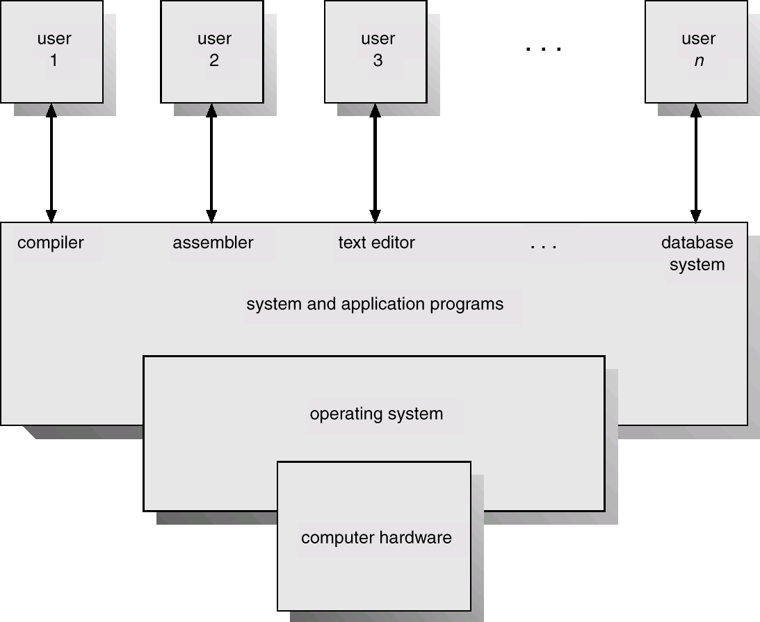
Abstract View of System Components
Operating System Concepts
1.4
Silberschatz, Galvin and Gagne 2002

Slide 5
Operating System Definitions
Resource allocator – manages and allocates resources.
Control program – controls the execution of user programs and operations of I/O devices .
Kernel – the one program running at all times (all else being application programs).
Operating System Concepts
1.5
Silberschatz, Galvin and Gagne 2002

Slide 6
Mainframe Systems
Reduce setup time by batching similar jobs
Automatic job sequencing – automatically transfers control from one job to another. First rudimentary operating system.
Resident monitor
  initial control in monitor
  control transfers to job
  when job completes control transfers pack to monitor
Operating System Concepts
1.6
Silberschatz, Galvin and Gagne 2002

Slide 7
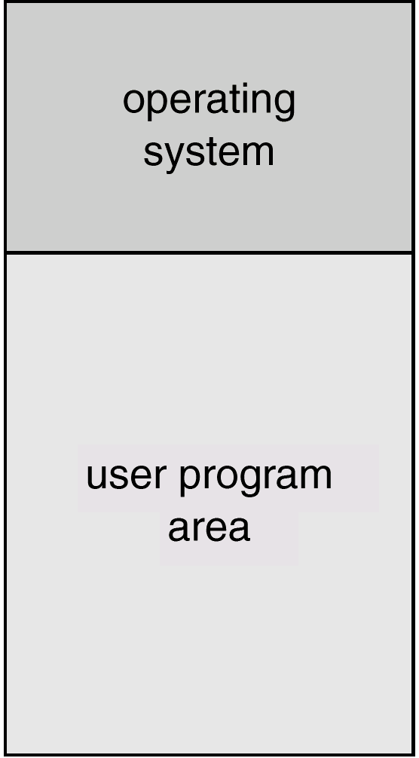
Memory Layout for a Simple Batch System
Operating System Concepts
1.7
Silberschatz, Galvin and Gagne 2002

Slide 8
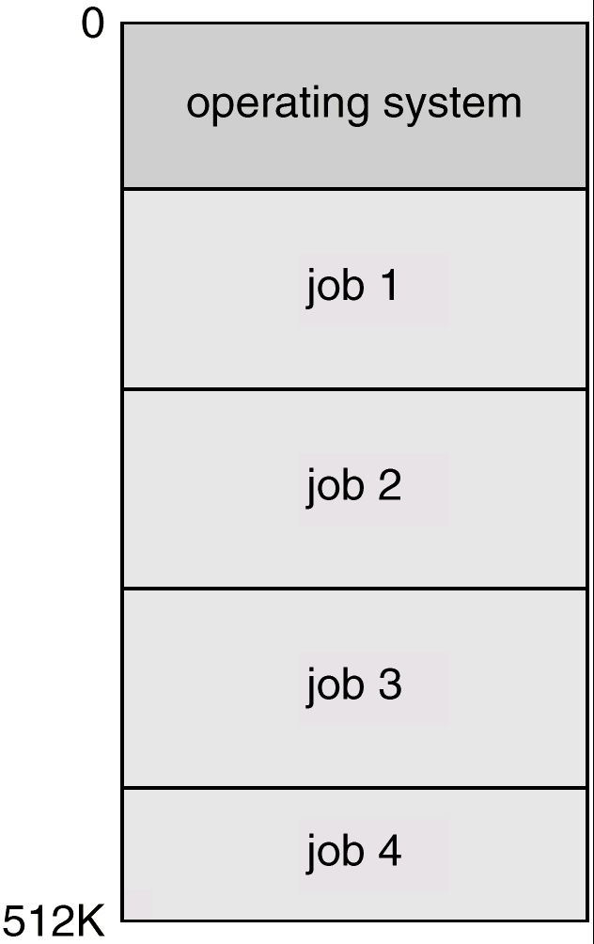
Multiprogrammed Batch Systems
Several jobs are kept in main memory at the same time, and the CPU is multiplexed among them.
Operating System Concepts
1.8
Silberschatz, Galvin and Gagne 2002

Slide 9
OS Features Needed for Multiprogramming
I/O routine supplied by the system.
Memory management – the system must allocate the memory to several jobs.
CPU scheduling – the system must choose among several jobs ready to run.
Allocation of devices.
Operating System Concepts
1.9
Silberschatz, Galvin and Gagne 2002

Slide 10
Time-Sharing Systems–Interactive Computing
The CPU is multiplexed among several jobs that are kept in memory and on disk (the CPU is allocated to a job only if the job is in memory).
A job swapped in and out of memory to the disk.
On-line communication between the user and the system is provided; when the operating system finishes the execution of one command, it seeks the next “control statement” from the user’s keyboard.
On-line system must be available for users to access data and code.
Operating System Concepts
1.10
Silberschatz, Galvin and Gagne 2002

Slide 11
Desktop Systems
Personal computers – computer system dedicated to a single user.
I/O devices – keyboards, mice, display screens, small printers.
User convenience and responsiveness.
Can adopt technology developed for larger operating system’ often individuals have sole use of computer and do not need advanced CPU utilization of protection features.
May run several different types of operating systems (Windows, MacOS, UNIX, Linux)
Operating System Concepts
1.11
Silberschatz, Galvin and Gagne 2002

Slide 12
Parallel Systems
Multiprocessor systems with more than on CPU in close communication.
Tightly coupled system – processors share memory and a clock; communication usually takes place through the shared memory.
Advantages of parallel system:
  Increased throughput
  Economical
  Increased reliability
✔ graceful degradation
✔ fail-soft systems
Operating System Concepts
1.12
Silberschatz, Galvin and Gagne 2002

Slide 13
Parallel Systems (Cont.)
Symmetric multiprocessing (SMP)
  Each processor runs and identical copy of the operating system.
  Many processes can run at once without performance deterioration.
  Most modern operating systems support SMP
Asymmetric multiprocessing
  Each processor is assigned a specific task; master processor schedules and allocated work to slave processors.
  More common in extremely large systems
Operating System Concepts
1.13
Silberschatz, Galvin and Gagne 2002

Slide 14
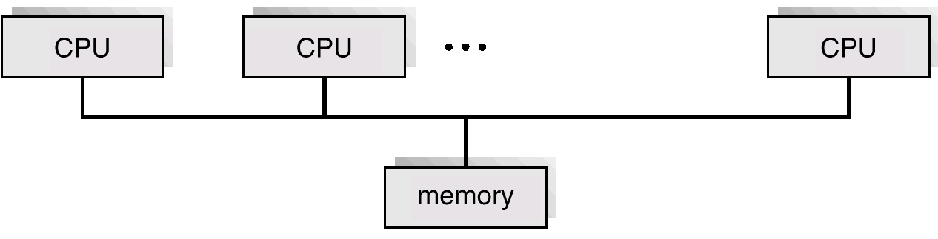
Symmetric Multiprocessing Architecture
Operating System Concepts
1.14
Silberschatz, Galvin and Gagne 2002

Slide 15
Distributed Systems
Distribute the computation among several physical processors.
Loosely coupled system – each processor has its own local memory; processors communicate with one another through various communications lines, such as high- speed buses or telephone lines.
Advantages of distributed systems.
  Resources Sharing
  Computation speed up – load sharing
  Reliability
  Communications
Operating System Concepts
1.15
Silberschatz, Galvin and Gagne 2002

Slide 16
Distributed Systems (cont)
Requires networking infrastructure.
Local area networks (LAN) or Wide area networks (WAN)
May be either client-server or peer-to-peer systems.
Operating System Concepts
1.16
Silberschatz, Galvin and Gagne 2002

Slide 17
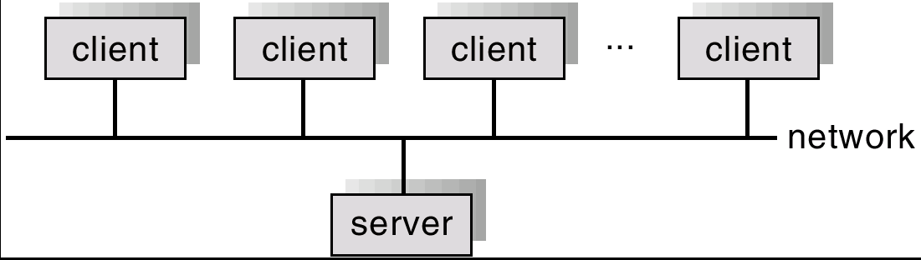
General Structure of Client-Server
Operating System Concepts
1.17
Silberschatz, Galvin and Gagne 2002

Slide 18
Clustered Systems
Clustering allows two or more systems to share storage.
Provides high reliability.
Asymmetric clustering: one server runs the application while other servers standby.
Symmetric clustering: all N hosts are running the application.
Operating System Concepts
1.18
Silberschatz, Galvin and Gagne 2002

Slide 19
Real-Time Systems
Often used as a control device in a dedicated application such as controlling scientific experiments, medical imaging systems, industrial control systems, and some display systems.
Well-defined fixed-time constraints.
Real-Time systems may be either hard or soft real-time.
Operating System Concepts
1.19
Silberschatz, Galvin and Gagne 2002

Slide 20
Real-Time Systems (Cont.)
Hard real-time:
  Secondary storage limited or absent, data stored in short term memory, or read-only memory (ROM)
  Conflicts with time-sharing systems, not supported by general-purpose operating systems.
Soft real-time
  Limited utility in industrial control of robotics
  Useful in applications (multimedia, virtual reality) requiring advanced operating-system features.
Operating System Concepts
1.20
Silberschatz, Galvin and Gagne 2002

Slide 21
Handheld Systems
Personal Digital Assistants (PDAs)
Cellular telephones
Issues:
  Limited memory
  Slow processors
  Small display screens.
Operating System Concepts
1.21
Silberschatz, Galvin and Gagne 2002

Slide 22
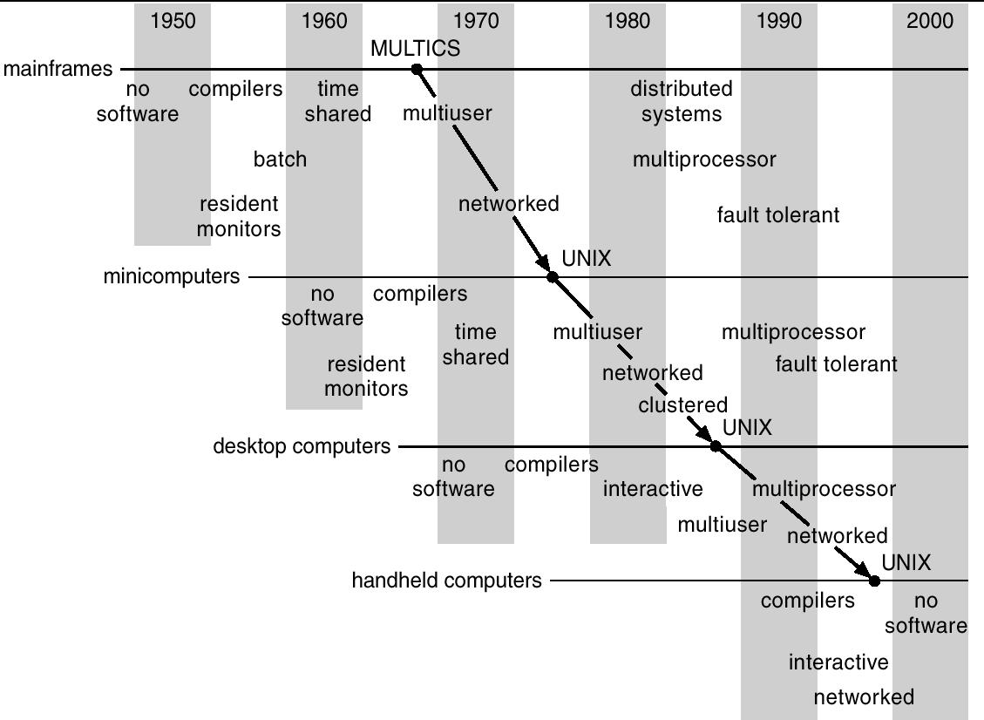
Migration of Operating-System Concepts and Features
Operating System Concepts
1.22
Silberschatz, Galvin and Gagne 2002

Slide 23
Computing Environments
Traditional computing
Web-Based Computing
Embedded Computing
Operating System Concepts
1.23
Silberschatz, Galvin and Gagne 2002

